Slide 1


Railway Management System
The Railway Management System offers a comprehensive solution for efficient train scheduling, booking, and staff management. It provides secure access for administrators and a seamless experience for users to plan their journeys.
Hafsa Maqsood

Slide 2
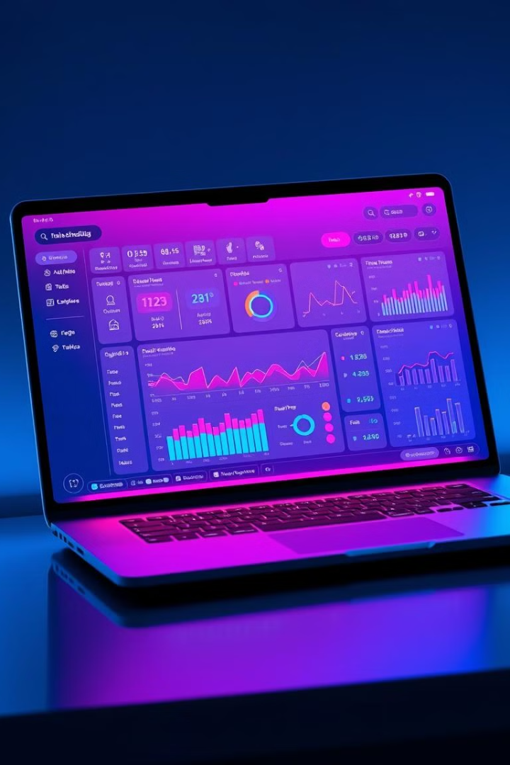
Admin Management
Schedule Management
Secure Login
Administrators can access the system through a secure login process, ensuring the integrity of train schedules and booking records.
Admins can add, update, search, and delete train schedules with ease, keeping the system up-to-date and responsive to changing needs.

Slide 3
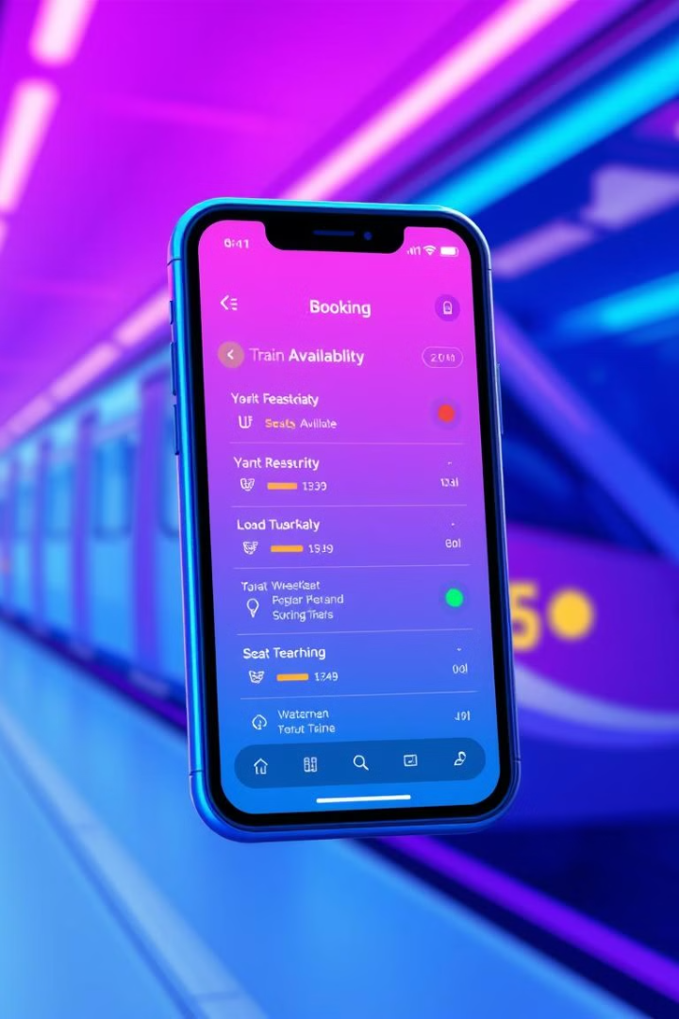


User Booking
Real-time Availability
Booking Status
Passengers can check the real-time availability of train seats and plan their journeys accordingly.
Users can view the status of their bookings, whether confirmed or waitlisted, to stay informed.

Slide 4
Booking Validation
Input Validation
The system thoroughly validates user input, ensuring that all necessary details are provided correctly.
Booking Confirmation
Bookings are only confirmed when all details are verified, providing a reliable and accurate service.

Slide 5

Staff Access
1
Train Details
Railway staff can access comprehensive information about train schedules, routes, and other key details.
2
Occupancy Tracking
Staff can monitor the real-time occupancy of trains, allowing them to provide better assistance to passengers.

Slide 6

Key Benefits and Conclusion
1
Efficient Operations
2
Enhanced User Experience
3
Cost
The Railway Management System streamlines train scheduling, booking, and staff management, leading to improved operational efficiency.
In this way we can reduce over cost using this online management system.
Passengers enjoy a seamless booking process with real-time availability and reliable confirmation, fostering customer satisfaction.

Slide 7

Thank You
Thank you for your interest in the Railway Management System. We are committed to delivering a cutting-edge solution that streamlines operations and enhances the passenger experience.

